Slide 1
Academy Department Planning
2013 - 2014

Slide 2
Core Ideology
Vision
Mission
Infrastructure
Data & Goals
Core Ideology + Better Future
Team’s Values + Purpose
Plan to Reach Future
Shared Team Responsibility

Slide 3
Our Mission
Our mission is to prepare students for college and career, emphasizing skills in business & finance. Students gain a competitive edge from relevant courses, real-world experiences, team collaboration, and industry partnerships. Through a supportive family environment, Academy students grow to be innovative, articulate, and socially conscious young adults who invest in their futures and communities.
Is this vision?

Slide 4
Our Core Values:
We value:
Investing in our futures
Being accountable for our actions and attitudes
Engaging in challenging and relevant education
Making a positive impact on our community
Striving for success
Fostering a supportive environment

Slide 5
Choosing Where to Focus
We can’t do it all. We might need to eliminate some activities or prioritize some things above others. AVG Ranks based on our survey:
Highest Ranks
Mentorships (ranked 1, unanimously)
Internships (ranked 2, unanimously)
Guest Speakers (ranked 3)
PBL Projects (ranked 4)
Academic Probation, Fieldtrips, Tutoring (tied ranked 5)
Lower Ranks:
AOBT Time
“Fun” Activities
Job Shadows
Simulations
Fun Trips

Slide 6
Executive Team (Vision, Goals, Progress, Management)
Staff: Mrs. Rush
Student: CEO
Human Resources Team (Accountability, Recognition, Team Building, Recruitment)
Finance Team
(Budgets, Spending, Accounting, Grant Funds)
Marketing Team
(Publicity, Promotion & Community Outreach)
Communications Team (Announcements, Achievements, Newsletter, Website)
Event Planning Team (Outside Activities, Celebrations, Fundraisers, Trips)
Staff: Mr. Roehrich
Student: Communications Manager
Staff: Mr. Colombo
Student: HR Manager
Staff: Mrs. Spillane
Student: Event Planning Manager
Staff: Walter
Student: Marketing Manager
Staff: Ms. Goodwin
Student: CFO

Slide 7
BHAG: Big Hairy Audacious Goals
People “get it right away:” little explanation needed
Students should “get it” easily , too
Tangible, energizing, clear finish line
A “mountain to climb” or “hurdle to jump over”
Bold, far-reaching
Clear & simple
Preserve core values
Stimulate progress
Creates momentum

Slide 8
Our Team Goals for 2013-14
100% of Academy students will be UC a-g eligible
The Academy will take an annual senior trip to San Francisco or NYC
The Academy will Adopt a Charity each year, donating time and money to that organization.
The Academy will receive 64 returned 10th grade contracts by June 2014. commitment to spread the word

Slide 9
Additional Goals Discussed in Aug 2014
Social Media presence/ service to staff? More visible to 9th graders/ martson
All students raise GPA by .5/ class raise AVG GPA by .5
Senior-sophomore adoption program
More AP advanced classes
Community service: homeless make over event? Career market? Manpower / Kiva
Once per grade period outside of school activity
Each student opens savings & savings goal + buy brokerage acct /real stock
Students exit with a digital portfolio
Scholarships attached to student store

Slide 10
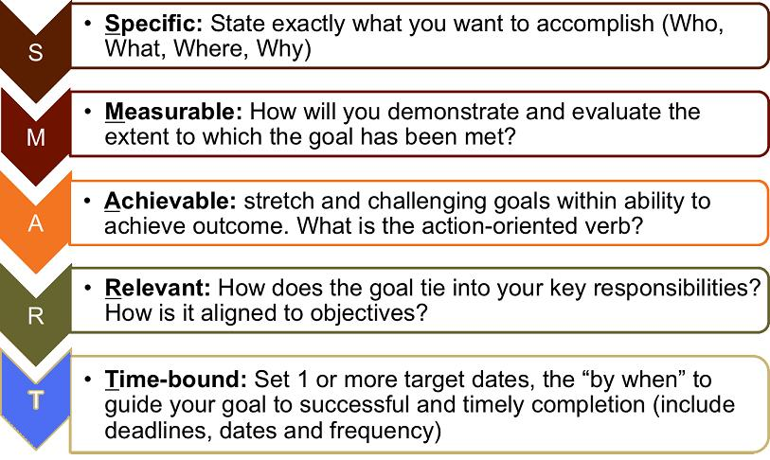
SMART Goal Setting

Slide 11
Finance Team- Suggested Student Role
The Academy Finance Team is in charge of accounting for all academy events, fundraisers, and activities. They will oversee the cash-flow, monitoring and budgeting all spending and raising of funds.
Collective Duties of Finance Team:
Create and monitor a budget for the Academy
Track all deposits, withdrawals, and reimbursements in and out of the Academy ASB account
Create monthly financial reports
Propose new fundraisers
Track student participation in fundraisers
Handle payment / cash register at Academy fundraisers and events

Slide 12
Human Resources Team – Suggested Student Role
The Academy Human Resources Team (HR) is in charge of fostering a positive work environment and family atmosphere in the Academy by overseeing student accountability, student recognition, team building, grade-level mentoring.
Collective Duties of HR Team:
Help monitor student "Accounts" in Personal Business Plan
Oversee cross-grade level activities and mentoring
Keep track of and recognize birthdays of Academy Students
Create monthly student awards for Academy 3.0 Club, other recognition
Organize get-well cards, thank-you cards, prizes, and celebrations for Academy students & teachers
Create new ways of raising morale and community in the Academy
Plan & Coordinate Academy team-building activities
Decorate Academy rooms for recognition, holidays, student work, upcoming activities, etc
Keep track of class competitions
Organize class clean-ups

Slide 13
Marketing Team – Suggested Student Role
The Academy Marketing Team is in charge of creating and maintaining a positive image for the Academy on the CHS campus and in the surrounding community. They oversee all aspects of publicity including: creation of promotional materials (digital & print), advertising campaigns, and event promotion.
Collective Duties of Marketing Team:
Create promotional video shorts for Academy recruitment & CHS bulletin
Create and order promo T-shirts, sweatshirts, pens, giveaways, etc
Create PowerPoint Presentations for marketing to Marston, campus, parents, etc
Create a promotional video for the academy
Take pictures and video clips at Academy events and organize them
Think of creative ways to advertise and make the AOB a well-known club on campus
Create the End-of-Year Slideshow
Make flyers, banners, and signs for Academy events

Slide 14
Communications Team – Suggested Student Role
The Academy Communications Team is in charge of making sure the students and staff of the Academy are well-informed of program events, and achievements through announcements, e-mails, social media, newsletters, and an updated website.
Collective Duties of Communications Team:
Update Academy Website on a weekly basis with announcements, recognition, pictures, posts, videos, upcoming events, etc.
Update online Academy Google calendar with weekly meetings, Academy events, etc
Get parents aware and involved in events
Create and manage an Academy contact list
Create and manage an Academy alumni list
Create and manage Academy social media sites
Create and send out a monthly newsletter (digital)
Maintain announcement boards in all Academy classrooms
Send out E-vites to events

Slide 15
Event Planning Team – Suggested Role
The Academy Event Planning team will be in charge of brainstorming, planning, and organizing all Academy extra-curricular activities, celebrations, fundraisers, and trips.
Collective Duties of Event Planning Team:
Keep a master calendar of events for Academy
Plan, organize monthly Academy events outside of school hours (BBQ’s, ice skating, bowling, etc.)
Organize club activities on campus (Club Rush, holiday treats, Academy time ice-breakers, etc.)
Plan and organize Academy fundraisers
Fill out official forms to get activities approved by ASB
Manage carpools and sign-up sheets for events and fieldtrips
Plan academy mentor luncheons & end-of-year banquet

